Slide 1


The Joys of Summer Reading
Original Summer Reading artwork by Annalisa Barelli
Presented by Melody Sky Eisler,
Library Director Port Townsend Public Library

Slide 2
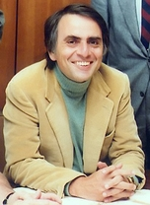
“What an astonishing thing a book is. It's a flat object made from a tree with flexible parts on which are imprinted lots of funny dark squiggles. But one glance at it and you're inside the mind of another person, maybe somebody dead for thousands of years. Across the millennia, an author is speaking clearly and silently inside your head, directly to you. Writing is perhaps the greatest of human inventions, binding together people who never knew each other, citizens of distant epochs. Books break the shackles of time. A book is proof that humans are capable of working magic." [Cosmos, Part 11: The Persistence of Memory (1980)]”
-Carl Sagan

Slide 3
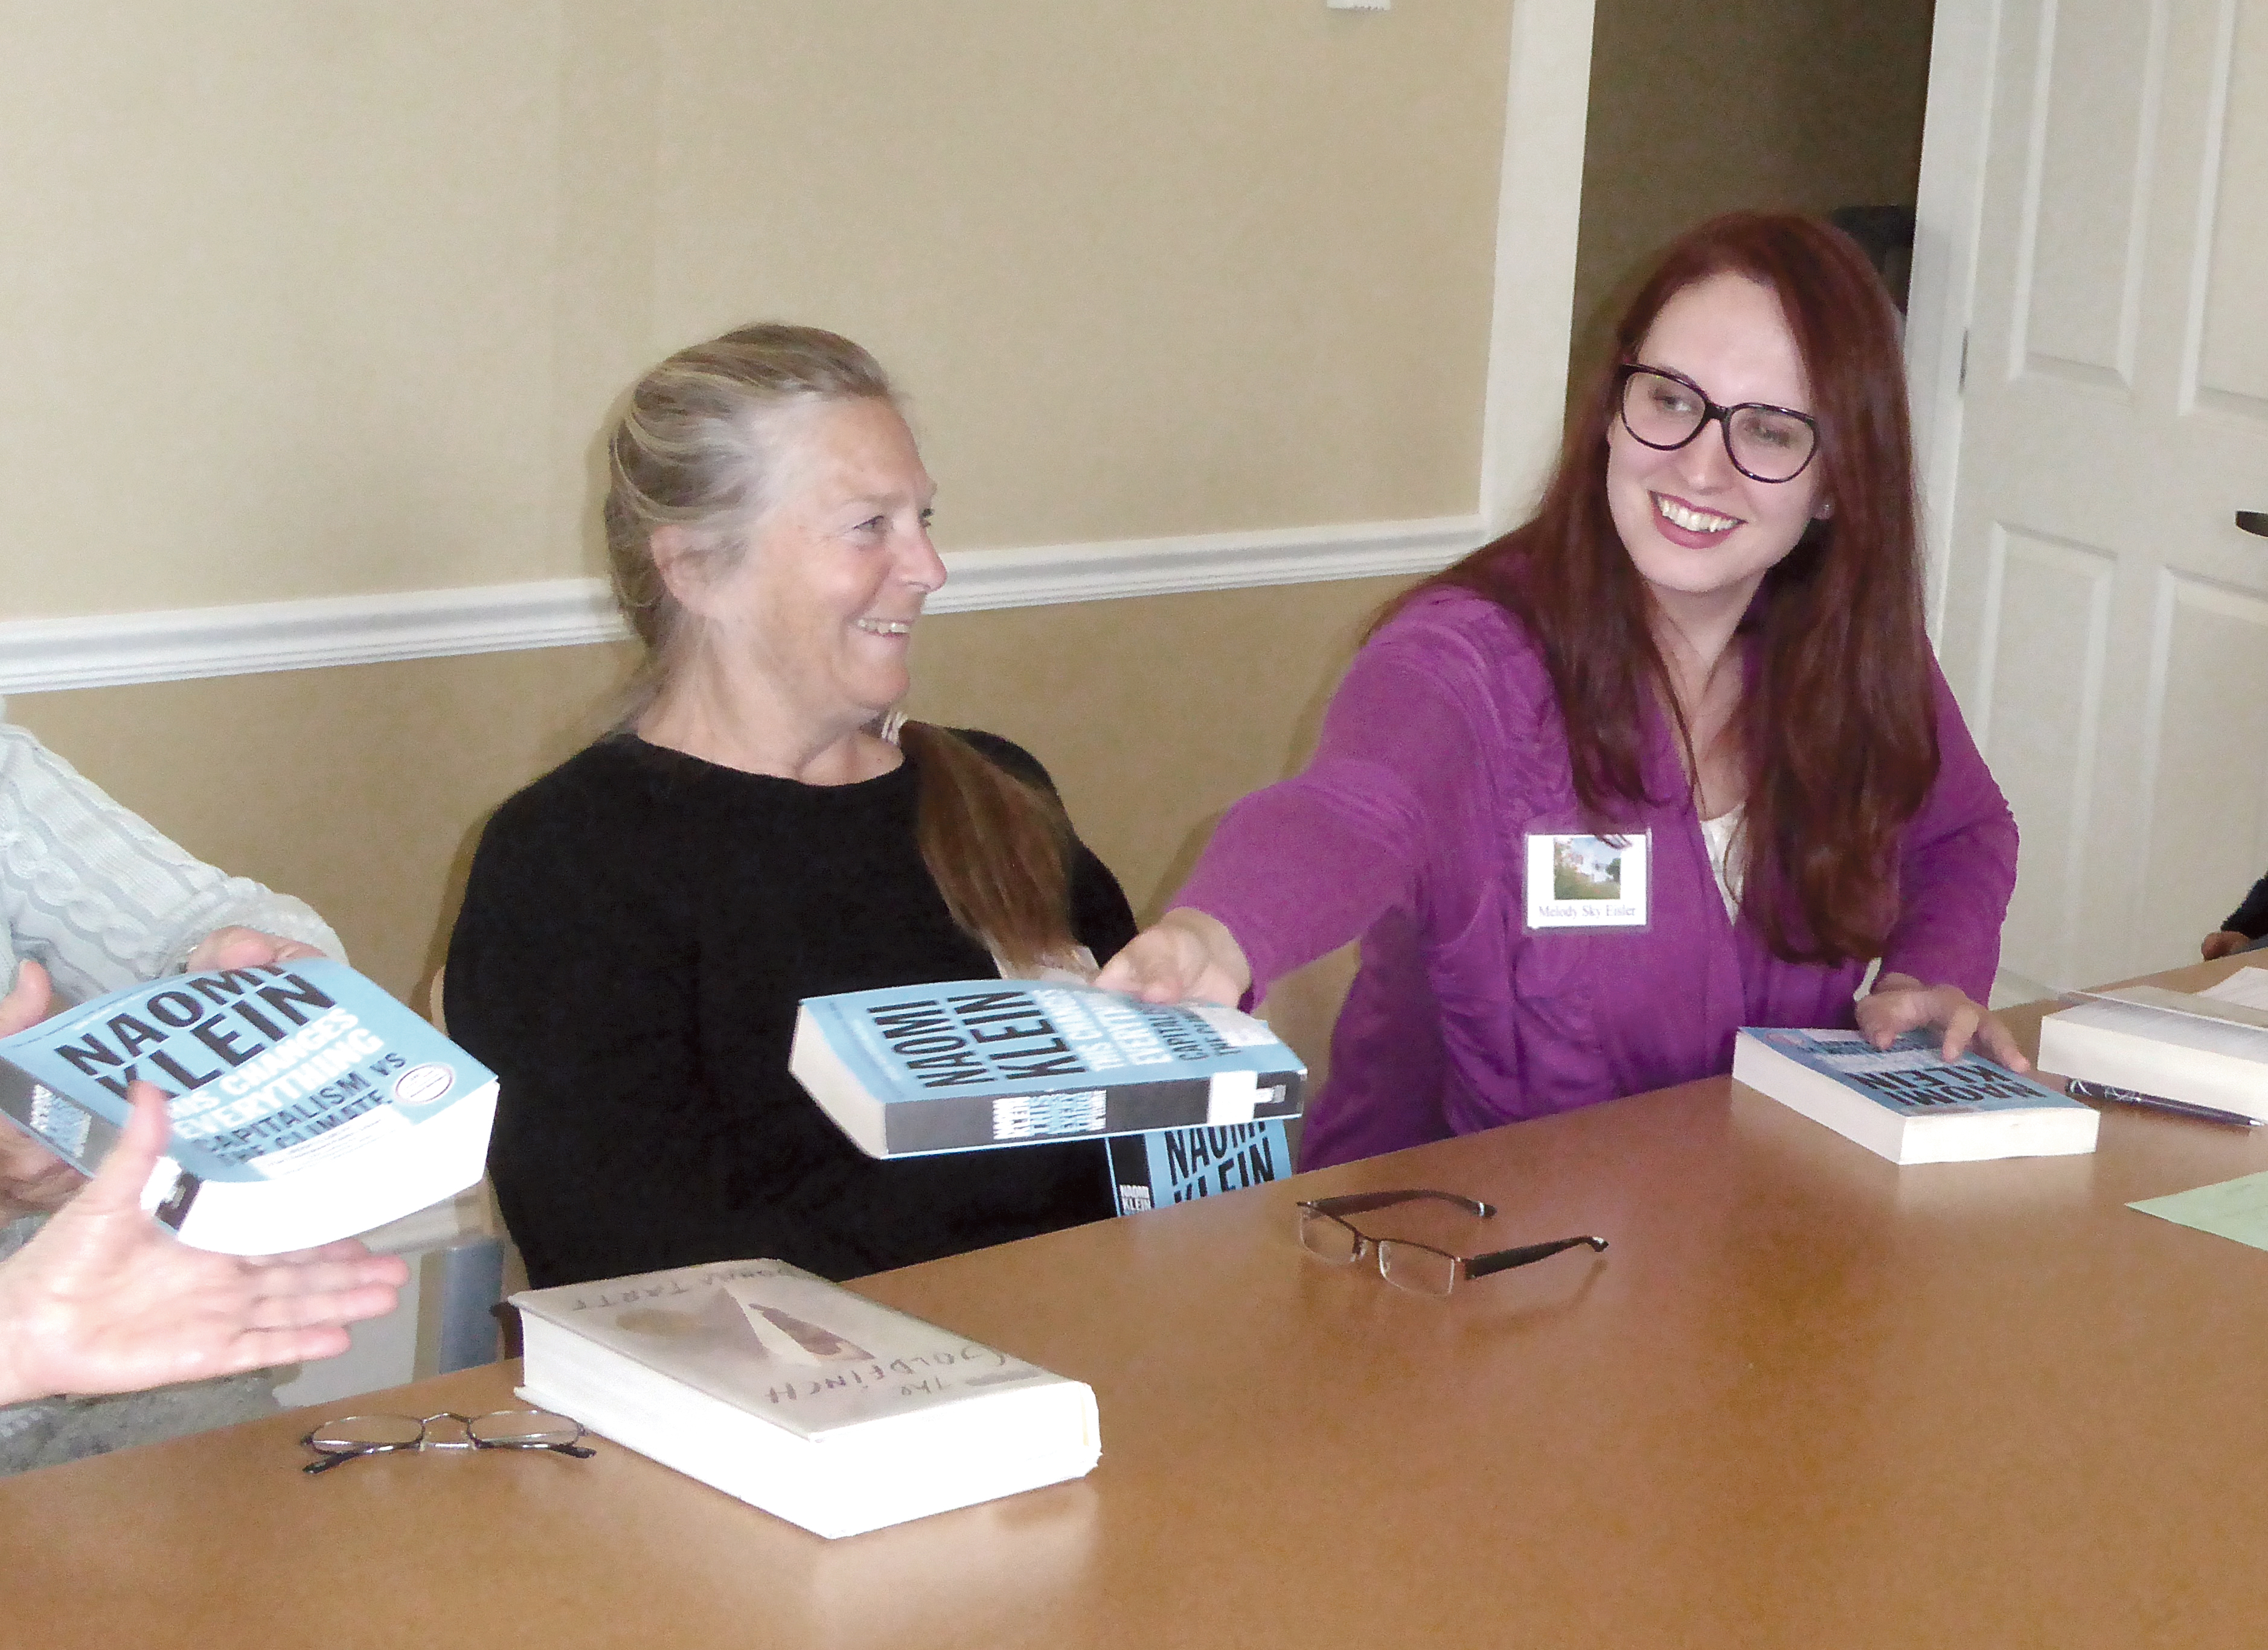
Confessions of a Book Pusher…
Fun science behind why reading is good for you
My recent favorite reads
The Great American Read (PBS)
A TED Reading List
Kitsap Regional Library’s
Summer Learning program with Lisa Lechuga
Q&A and share and tell…

Slide 4

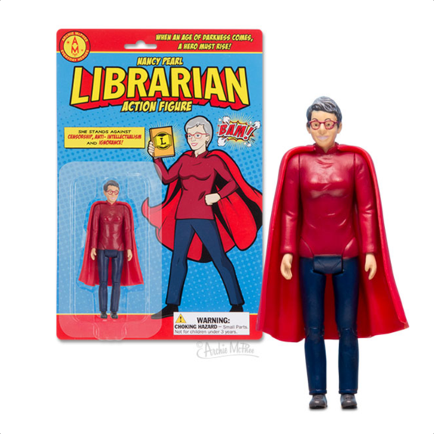
No required reading!
“What is a great book? It is a book that YOU have enjoyed. That is a great book.”- Nancy Pearl

Slide 5
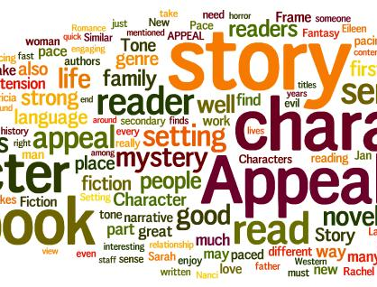
Reader’s Advisory @ Your Library!
Did you know your friendly librarians can help you find your next great read!
Seriously, it is one of the best parts of the job!

Slide 6
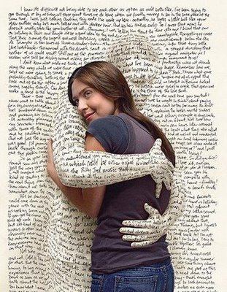
Reading is GOOD for you!
“The Real-Life Benefits of Reading Fiction” 2018
https://www.psychologytoday.com/us/blog/your-future-self/201806/the-real-life-benefits-reading-fiction
Empathy
Longevity
Sharper and healthier mind
“A Reading Hug” from http://russonreading.blogspot.com/2016/03/reading-our-way-to-empathy.html

Slide 7
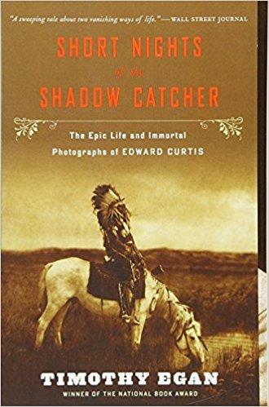
Melody’s Reads
Short Nights of the Shadow Catcher, The Epic Life and Immortal Photographs of Edward Curtis by Timothy Egan
Seattle Art Museum Show: Double Exposure June 14- September 9
Double Exposure: Edward S. Curtis, Marianne Nicolson, Tracy Rector, Will Wilson: features 150 images by a historic photographer, alongside immersive experiences from three contemporary artists. Across a spectrum of media rooted in lens-based processes, all four artists contribute to a complex and ever-expanding portrait of Native America
http://doubleexposure.site.seattleartmuseum.org/

Slide 8

PBS The Great American Read
List of America’s 100 most-loved novels brought to you by The Great American Read and readers across the country.
Read, watch, vote.
Diverse selection
http://www.pbs.org/the-great-american-read/books/#/

Slide 9
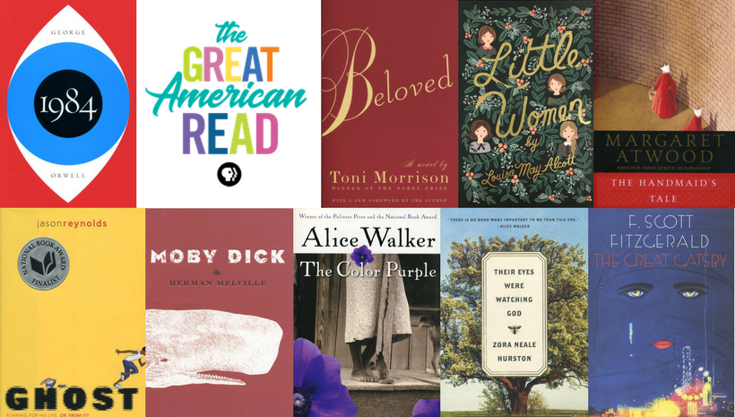
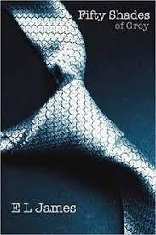
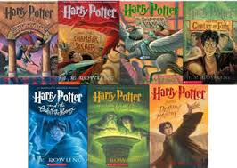
PBS The Great American Read

Slide 10
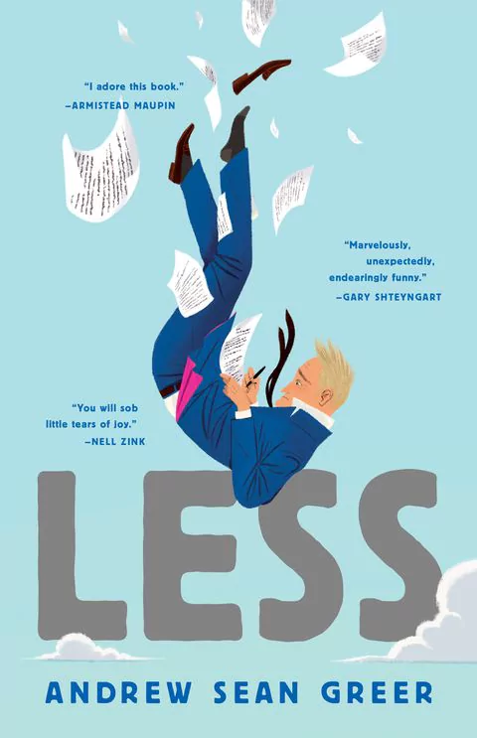
Melody’s Reads
Less by Andrew Sean Greer
2018 Pulitzer Prize for Fiction – rare to have a humorous book win!

Slide 11
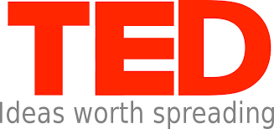

The TED 88 Reading List
Whether your weeks ahead contain travel, vacations or just longer and lazier days than usual, our list of recommendations from TED speakers has books for all moods, activities and tastes
https://ideas.ted.com/88-books-to-enjoy-this-summer-the-ted-reading-list/?utm_campaign=social&utm_medium=referral&utm_source=facebook.com&utm_content=ideas-blog&utm_term=education

Slide 12
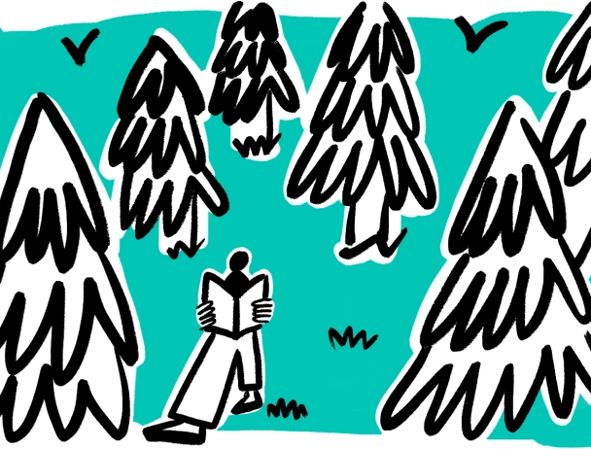
The TED Reading List
When you want to understand why we humans do what we do
How Emotions Are Made: The Secret Life of the Brain
When you’re with your family — but want to read about other people’s
Kintu ( pre-colonial and contemporary Uganda)
When you want to take an existential vacation in someone else’s life
Eunice: The Kennedy Who Changed the World
When you want to learn about nature
Forest Bathing: How Trees Can Help You Find Health and Happiness

Slide 13
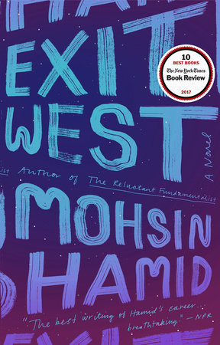
Melody’s Reads
Exit West by Mohsin Hamid
Magical realism and diaspora

Slide 14
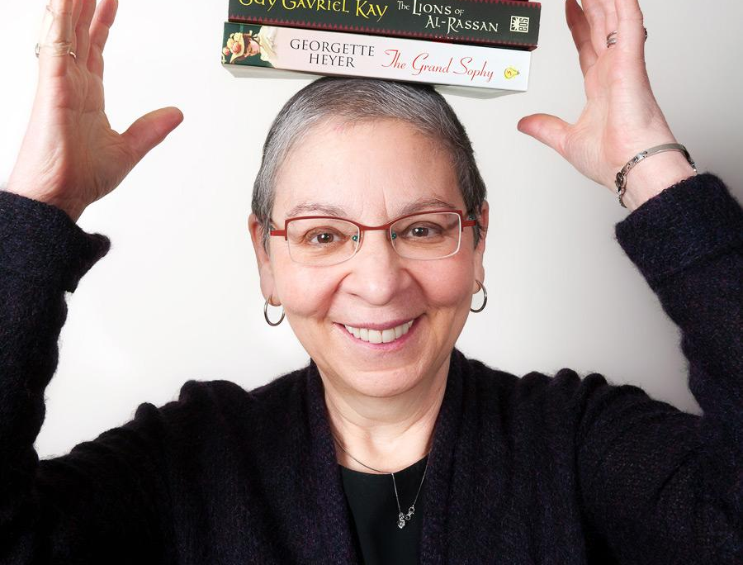
Reading “Rule of 50”
“I live by what I call 'the rule of fifty,' which acknowledges that time is short and the world of books is immense. If you're fifty years old or younger, give every book about fifty pages before you decide to commit yourself to reading it, or give it up. If you're over fifty, which is when time gets even shorter, subtract your age from 100. The result is the number of pages you should read before deciding. At 100 you can literally judge a book by its cover!”
-Nancy Pearl, America’s Librarian

Slide 15
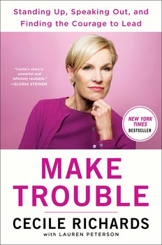
Melody’s Reads
Make Trouble: Standing Up, Speaking Out, and Finding the Courage to Lead by Cecile Richards
Get in an activist mood!

Slide 16

Live Longer- Join a Book Club
INDYPULSE:
SOCIAL ACTIVITIES SUCH AS BOOK CLUBS JUST AS IMPORTANT AS FITNESS TO HELP YOU LIVE LONGER, SAYS STUDY
Independent Article: https://www.independent.co.uk/life-style/health-and-families/health-news/social-activities-such-as-book-clubs-just-as-important-as-fitness-to-help-you-live-longer-says-study-a6875596.html
University of Queensland brief article:
https://www.uq.edu.au/news/article/2016/02/want-longer-life-join-club
BMJ Open- research article “Social group memberships in retirement are associated with reduced risk of premature death: evidence from a longitudinal cohort study” http://bmjopen.bmj.com/content/6/2/e010164

Slide 17

Audiobooks and Road Trips
Check out CDs
Download eAudiobooks on Overdrive or Libby
Audiobooks DO count as reading ☺

Slide 18
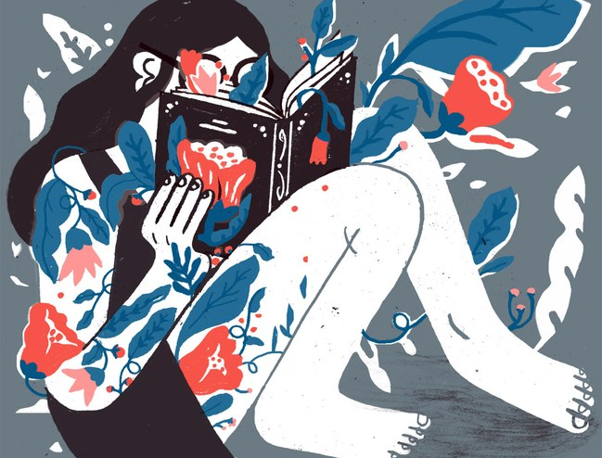
Reading Makes us Happy
Bibliotherapy/Literary Apothecary
https://www.newyorker.com/culture/cultural-comment/can-reading-make-you-happier
Reading has been shown to put our brains into a pleasurable trance-like state, similar to meditation, and it brings the same health benefits of deep relaxation and inner calm.

Slide 19
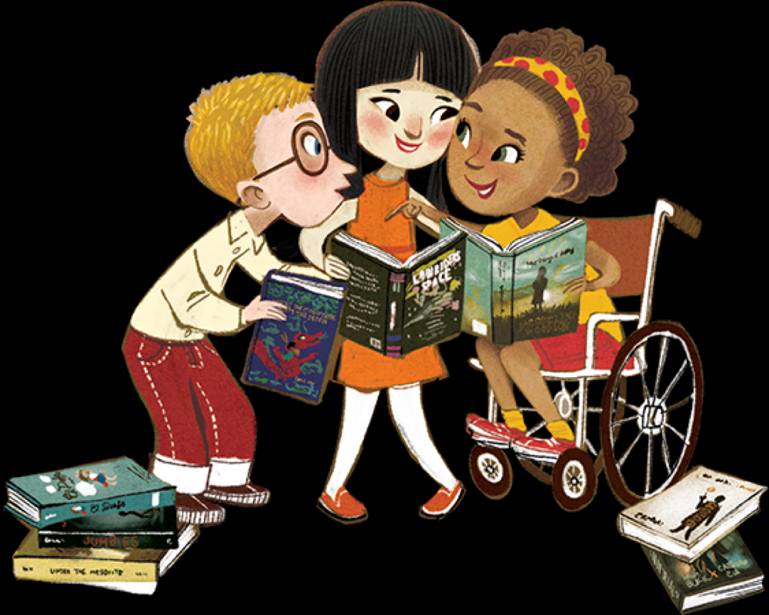
Imagine a world in which all children can see themselves in the pages of a book.
We Need Diverse Books https://diversebooks.org/
If they can see they can dream it and be it!

Slide 20

Welcome Lisa Lechuga, Community Engagement Manager for Kitsap Regional Library

Slide 21
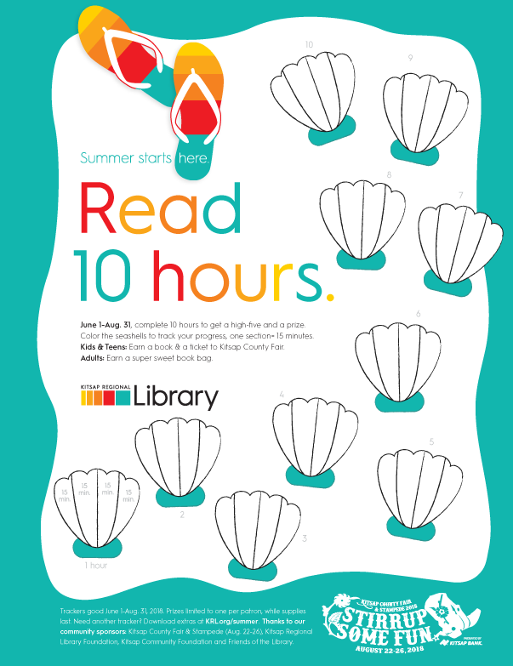
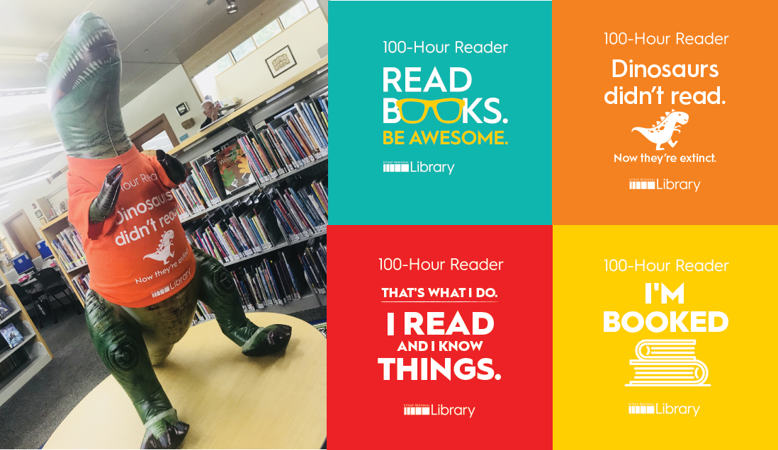
Kitsap Regional Library’s Summer Learning

Slide 22
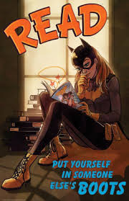
Q & A and Share & Tell….

Slide 23
Resources:
Kitsap Regional Library’s Summer of Learning program
https://www.krl.org/summer
Psychology Today: “The Real-Life Benefits of Reading Fiction”
https://www.psychologytoday.com/us/blog/your-future-self/201806/the-real-life-benefits-reading-fiction
The Great American Read by PBS
Learn more: https://www.pbs.org/the-great-american-read/home/
Reading list: https://bento.cdn.pbs.org/hostedbento-prod/filer_public/greatamericanread/TGAR_BookChecklist_2018.pdf
88 books to enjoy this summer: the TED reading list
https://ideas.ted.com/88-books-to-enjoy-this-summer-the-ted-reading-list/?utm_campaign=social&utm_medium=referral&utm_source=facebook.com&utm_content=ideas-blog&utm_term=education
Longevity Research and Social Groups: Live Longer… Join a Book Club!
https://www.uq.edu.au/news/article/2016/02/want-longer-life-join-club
BMJ Open- research article “Social group memberships in retirement are associated with reduced risk of premature death: evidence from a longitudinal cohort study” http://bmjopen.bmj.com/content/6/2/e010164
The New Yorker: “Can Reading Make You Happier?”
https://www.newyorker.com/culture/cultural-comment/can-reading-make-you-happier
We Need Diverse Books https://diversebooks.org/

